Slide 1
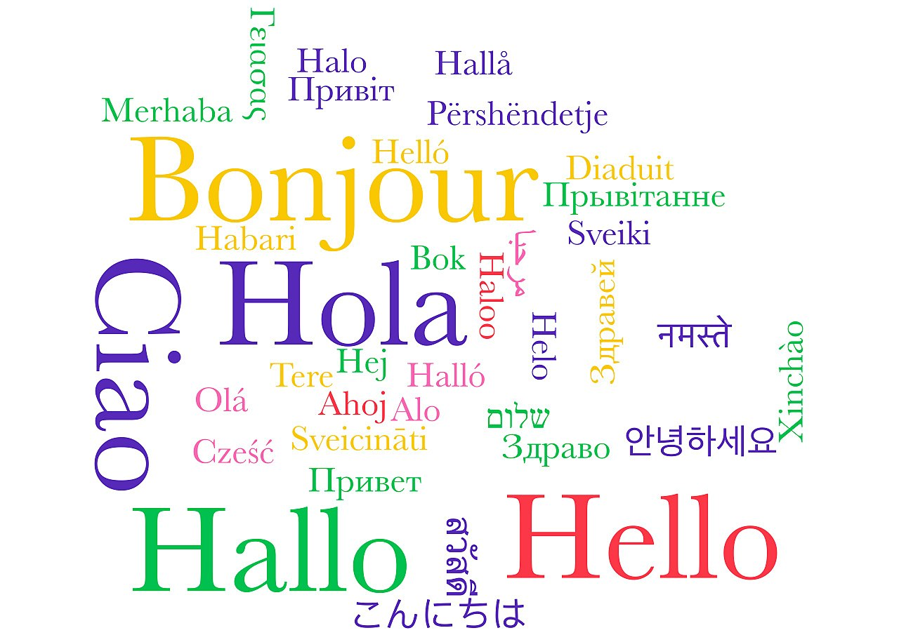
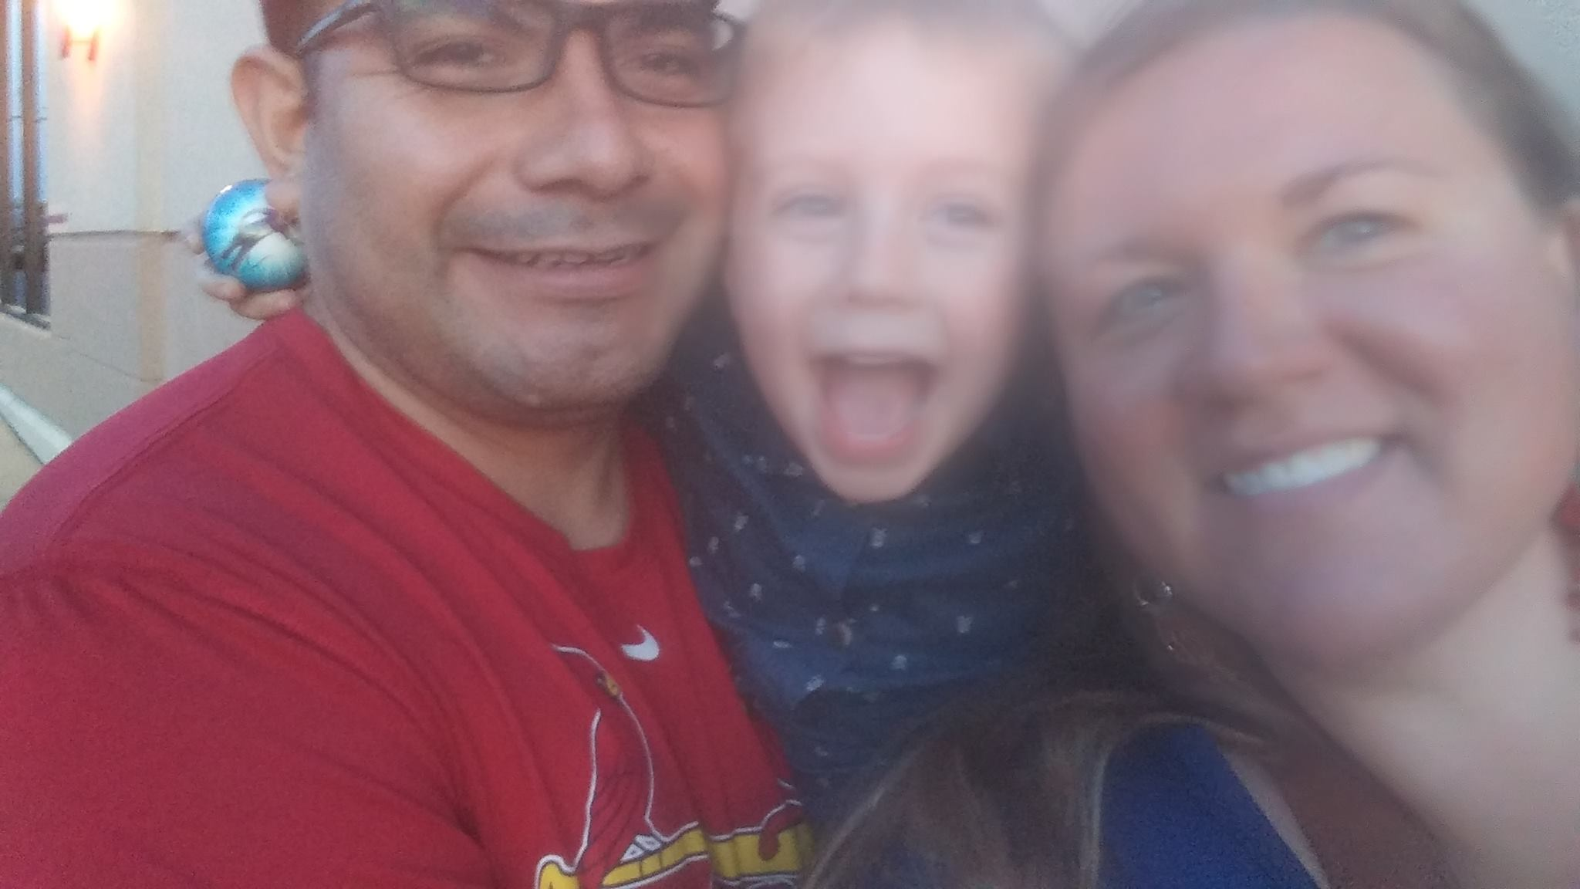
Ms. Angel Lichtenberg- ElL Teacher
I am so excited to get to know my students this year! Woerner is a diverse school with students from 22 different countries. Did you know that there are 17 different languages spoken at Woerner? Our students have a great desire to learn. My job is to help them use their funds of knowledge to learn. Students will have the opportunity to participate in lessons, achieve their goals, and grow as a people. All of my students can and will be successful in a safe and caring environment.
My home language is Spanish. What is your home language?
This Photo by Unknown Author is licensed under CC BY-SA

Slide 2
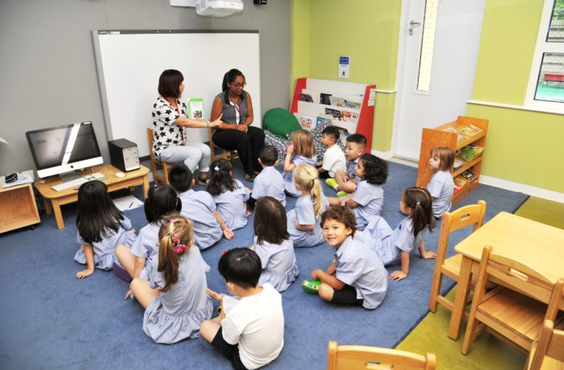
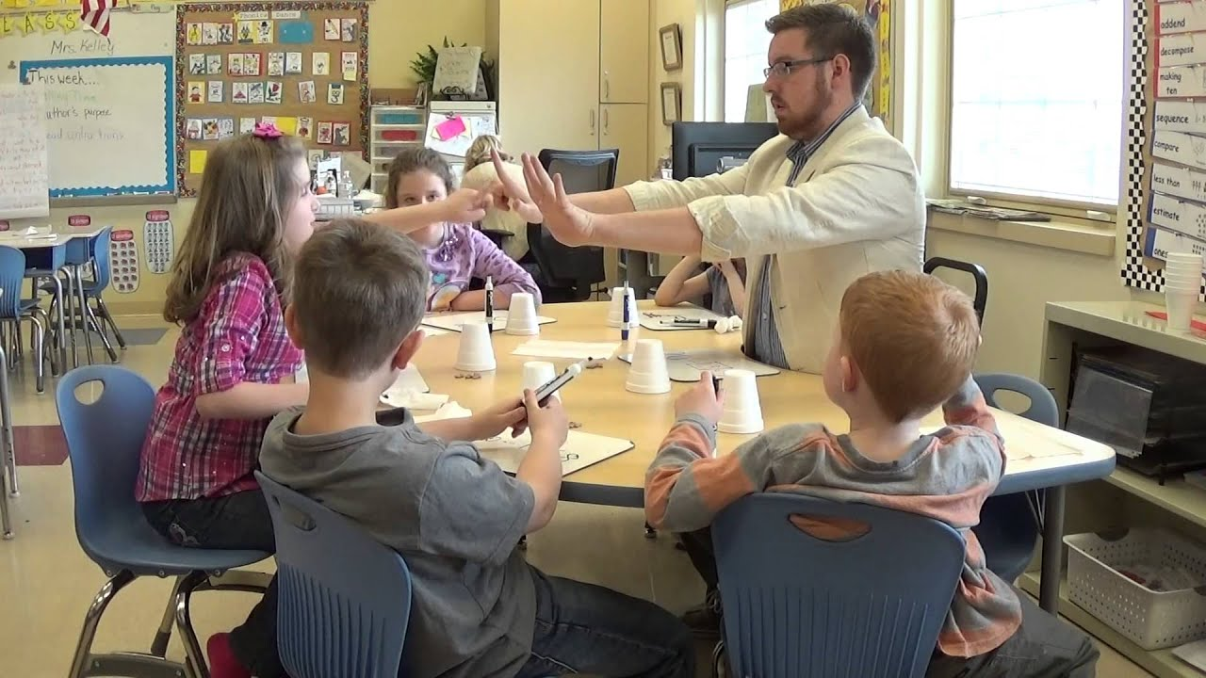
How will my child receive ELL support time?
Co-Teaching with Classroom Teachers
Small Groups – groups of students who need help with a certain topic or skill
Supports in Lessons- pictures, teacher demonstrations, word banks, vocabulary anchor charts

Slide 3
IMPORTANT INFORMATION
I will be sending home or emailing important forms and our learning schedule.
Please contact me with any questions or concerns.
Angelique.Lichtenberg@slps.org
(314) 956-2992

